Slide 1
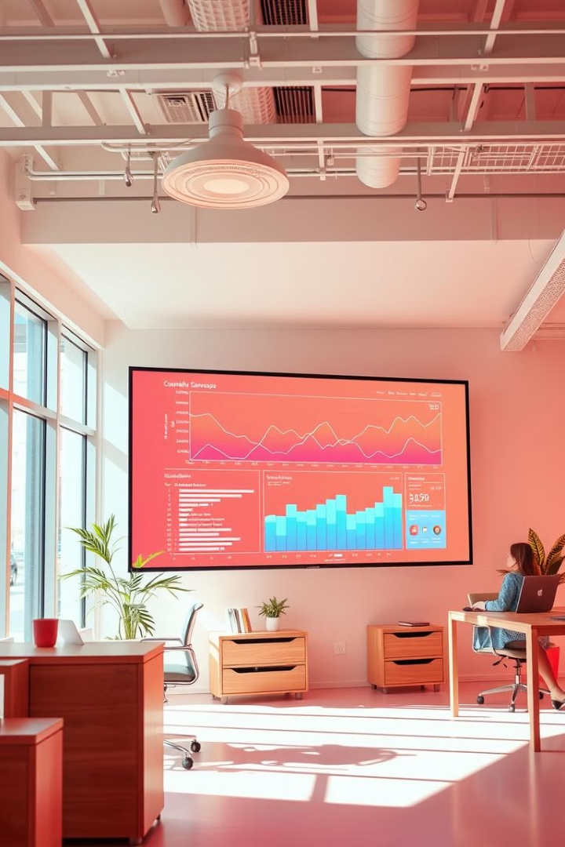
Exploratory Data Analysis for Global Electronics
By
Siva Nanthini M
6-09-2004

Slide 2
Agenda
Introduction
Data Overview
Methodology
Key Findings
Recommendations

Slide 3

Introduction
Company Overview
Global Electronics, a leading retailer of consumer electronics, has provided you with several datasets containing information about their customers, products, sales, stores, and currency exchange rates.
Objective
Describe the purpose of the EDA, focusing on enhancing customer satisfaction, optimizing operations, and driving growth.

Slide 4

Data Overview
Datasets
Customers
Products
Sales
Stores
Currency Rates
Data Sources
Internal databases, external sources
Internal databases, external sources
Internal databases, external sources
Internal databases, external sources
Internal databases, external sources
Data Dimensions
Number of records and key attributes in each dataset
Number of records and key attributes in each dataset
Number of records and key attributes in each dataset
Number of records and key attributes in each dataset
Number of records and key attributes in each dataset

Slide 5

Methodology
1
Data Cleaning and Preparation
Steps to clean, preprocess, and merge data.
2
SQL Database Integration
Loading data into SQL database.
3
Power BI Visualization
Use of Power BI for data visualization.
4
SQL Queries
Development of SQL queries to extract insights.

Slide 6
Customer Analysis
Demographic Distribution
Purchase Patterns
Customer Segmentation
Gender, age, location.
Average order value, purchase frequency.
Based on demographics and purchase behavior.

Slide 7
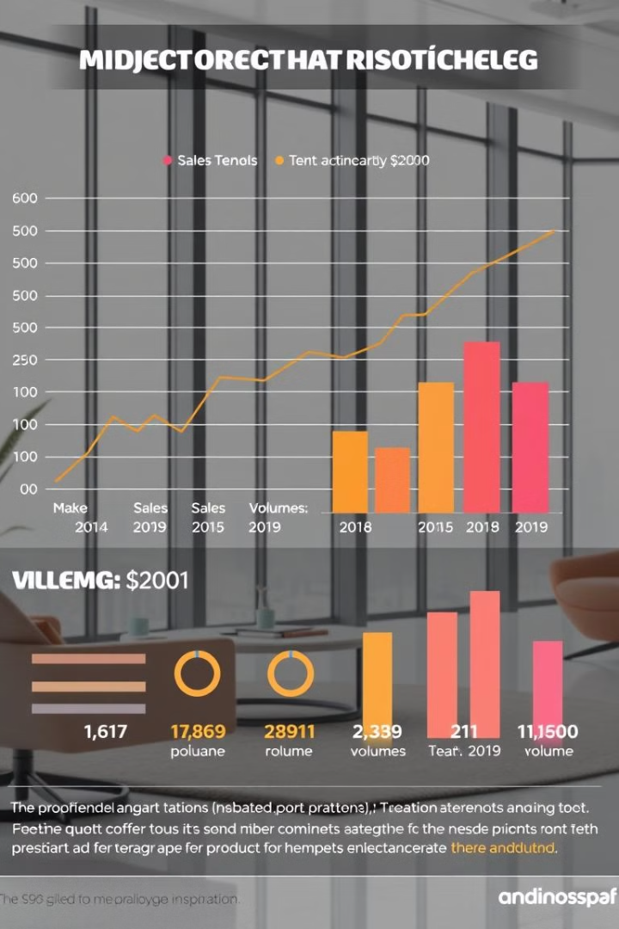
Sales Analysis
1
Overall Sales Performance
Trends in sales over time.
2
Sales by Product
Top-performing products by sales quantity and revenue.
3
Sales by Store
Store performance based on sales data.
4
Sales by Currency
Impact of currency exchange rates on sales.

Slide 8
Product Analysis
Product Popularity
Profitability Analysis
Category Analysis
Most and least popular products.
Profit margins across products.
Sales performance across product categories.

Slide 9

Store Analysis
1
Store Performance
2
Geographical Analysis
Sales, size, and operational data.
Sales distribution by store location.

Slide 10

Recommendations
Customer-Centric Strategies
Create special marketing offers and loyalty programs based on different customer groups.
Product Management
Suggest changes in stock levels and sales promotions for the best and worst-selling products.
Store Improvement
Recommend opening or closing stores based on where sales are strongest or weakest.
Pricing Strategy
Adjustments to international pricing based on currency impact analysis.
Notes:
• We've identified several key recommendations to help drive better business performance. • First, we suggest implementing more customer-centric marketing strategies, like tailored campaigns and loyalty programs. This will help us better engage and retain our most valuable customers. • On the product management side, we recommend making inventory adjustments and running targeted promotions for our best and worst-selling items. This will optimize our product mix and sales. • For our store network, we suggest using geographical sales data to guide decisions around store expansions or closures. This will ensure we have the right store footprint in the right locations. • Finally, we propose adjusting international pricing based on currency exchange rate analysis. This will help us maintain profitability as exchange rates fluctuate.

Slide 11
Thank You

